Slide 1

STUDENT PERSONILAZATION WEBSITE
TRACK - ED TECH
Page 01

Slide 2


INRODUCTION
Now a days we are seeing many of the students are losing the productivity and efficiency in doing work. As it’s said today’s kids are tomorrow pillars of the country. For those pillars to be strong, there should be some ground work to be done for the students to increase their efficiency and productivity towards their work.
LEARN MORE
OUR WEBSITE NAME:
SCHOLA
Page 02

Slide 3

PROBLEM STATEMENT :
There is a gap between the students and the education, because in todays generation students should be in pace with the fast paced education environment ,to effectively manage and organize their learning resources,as this that might be some extra work for the students, this leads to lack of productivity. This results in students to stay demotivated and retained with the old information and not effectively manage their studies.
@reallygreatsite
For More Information
Page 03

Slide 4


OUR VISION & MISSION
Our vision is to mould students into critcal thinkers , compassionate leaders and lifelong learners in transformative environment.
We always aspire to make students to acquire knowledge, skills and learning new emerging technologies to excel in a rapidly changing world.
Page 04

Slide 5
OUR SOLUTION :
We came with an website where student can effectively manage their studies and be at pace with the new information of the tech skills.There are other features and services provided which can help the student to organize their studies and increase productivity. Services we provide are listed in the next slide.
Page 05

Slide 6



Services
Personal Timetable
Timestamped Video Insights
Doubts Panel
Educator Portal
Tech News Portal
Automated PDF Summaries
AI Chatbot
AI-Generated Questions
Smart To-Do List
Page 06

Slide 7
Timestamped Insights for YouTube Videos: Students can seamlessly add and organize insightful notes linked to specific timestamps within YouTube videos, enhancing their learning experience by allowing easy reference and review.
Automated Question Generation from PDFs: Advanced algorithms generate thought-provoking questions from PDF content, helping students test their understanding and educators create assessments with ease.
Online Educator Portal: A dedicated portal for teachers to manage courses, interact with students, upload resources, and provide real-time feedback, fostering a collaborative learning environment.
To-Do List with Real-Time Notifications: An intelligent to-do list that not only helps students track tasks but also sends real-time notifications and reminders to keep them on schedule.
Automated Short Notes from PDFs: AI-powered tools generate concise and relevant summaries from PDF documents, enabling students to grasp key concepts quickly and efficiently.
Doubts Panel: An interactive forum where students can post and resolve queries, collaborate with peers, and receive guidance from educators, fostering a supportive learning community.
Page 07

Slide 8
Personalized Timetable: A customizable timetable that adapts to students' individual schedules, optimizing their study time and balancing academic and personal activities.
Personalized AI Chatbot: A smart chatbot tailored to individual learning needs, offering personalized support, answering questions, and guiding students through their academic journey.
Daily Tech News Portal: A dynamically updated portal providing the latest news on emerging technologies, keeping students informed about advancements and trends in the tech world.
Page 08

Slide 9
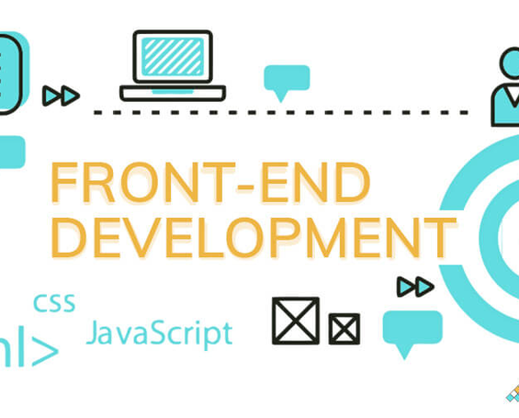


TECHNICAL TOOLS
FRONTEND TOOLS:
BACKENT TOOLS :
DATA BASE:
React JS, CSS
Node JS, Express JS
Azure - SQL
Page 09

Slide 10
TARGET AUDIENCE
Primary Audience :
Our Primary Audience are the students and self learners who seek for a more organized and effiecient way to manage theire studies. Our services help the self learners to engage with our online tools to enhance their learninig process and increase their productivity.
Secondary Audience :
Our Secondary Audience are the educators and the online tutors who are intrested in tutoring other students and wanted to share their streamline resources and also to earn money.
Even educational institutes can also use this website for tracking their students progress and also integrate all innovative tools to their curriculum.
Page 10

Slide 11
SCALABILITY AND FEASIBILITY
SCALABILITY :
Technical Scalability: The use of cloud-based infrastructure allows the platform to scale as user demand grows. Load balancing, horizontal scaling of the backend, and database replication will ensure the system can handle increased traffic.
FEASIBILITY :
Technical Feasibility: The project is technically feasible with current technologies. The use of established web development frameworks, cloud services, and AI/ML models ensures that the necessary components are readily available and can be effectively integrated.
Page 11

Slide 12
IMPACT
EDUCATIONAL IMPACT :
By providing automated notes, AI-generated questions, and a personalized timetable, the platform helps students optimize their study time and improve retention.The platform offers tools that make learning resources more accessible and organized, especially for students with diverse learning needs.
INSTITUTIONAL IMPACT:
Educators can use the platform to manage their resources more efficiently, interact with students, and provide timely feedback. Institutions can gain insights into student performance and engagement through analytics, enabling more targeted interventions.
SOCIAL IMPACT:
By making advanced educational tools widely available, the platform can help reduce the educational gap, especially for students in under-resourced areas.The platform’s features encourage continuous learning beyond formal education, equipping users with tools for self-improvement.
Page 12

Slide 13
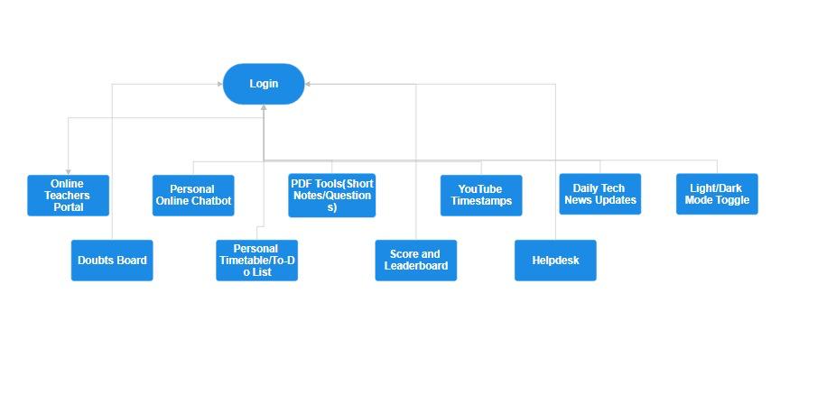
FLOW CHART:
Page 13

Slide 14

THANK YOU
TEAM NAME - ONE’S AND ZERO’ES
Page 14

